Slide 1
Robot DESIGN Lesson
Gyro Sensor Positioning

Slide 2
How Many Gyros should your robot have?
Depends on how many different axis you want to measure
For example, if you were making a joystick, you might need two
Note: We conducted a test to see if adding two gyro sensors will allow you to cancel out drift.
Our tests show that two sensors may allow you to average your error, but do not cancel/reduce the drift.
To learn about drift and lag, see our Gyro programming lessons in Advanced.

Slide 3
GYRO SENSOR PLACEMENT For MEASURING TURNS
The gyro sensor can be placed any where on the robot.
However, the “correct” position depends on what you are building
If you are using the gyro to measure turns, some positions just will not work. (Refer to images on this page)
X
X
✓
X

Slide 4
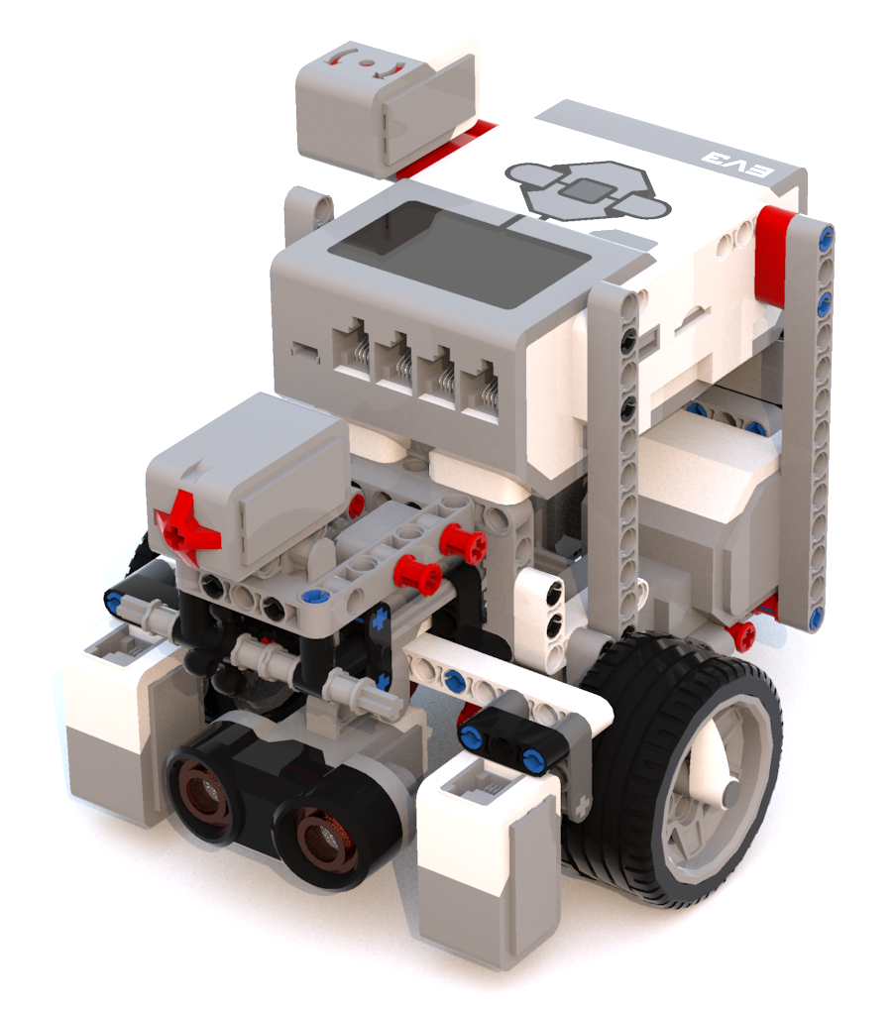
Sample Installations of the gyro
In this robot, the Gyro Sensor is prominently visible
The symbol on the sensor is parallel to the ground

Slide 5
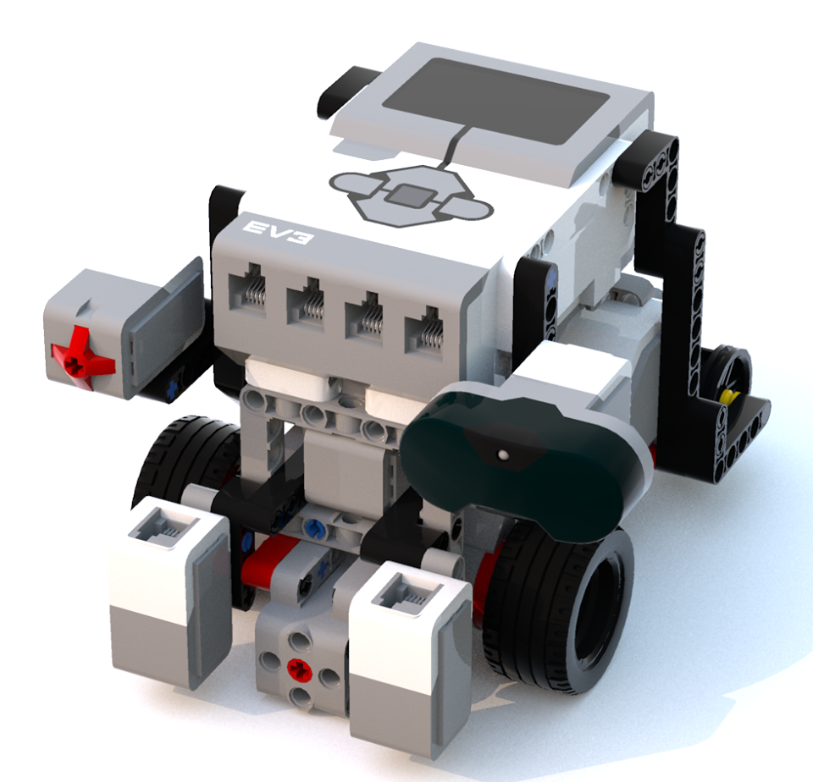
Sample Installations of the gyro
In this robot, the Gyro Sensor is barely visible and under the brick
The symbol on the gyro is still parallel to the ground
Tip: Place the sensor where you have space on the robot (somewhere hidden away is fine as you do not really need access to it once you connect it).

Slide 6
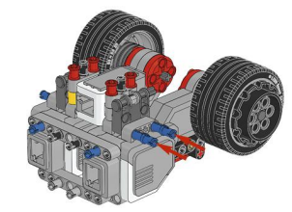
GYRO POSITION For a balancing robot
The gyro needs to be placed based on what you are trying to do
For a balancing robot (such as Gyro Boy) you need to have to gyro facing the sky or the ground
The gyro sensor in this model is hidden between the two motors

Slide 7
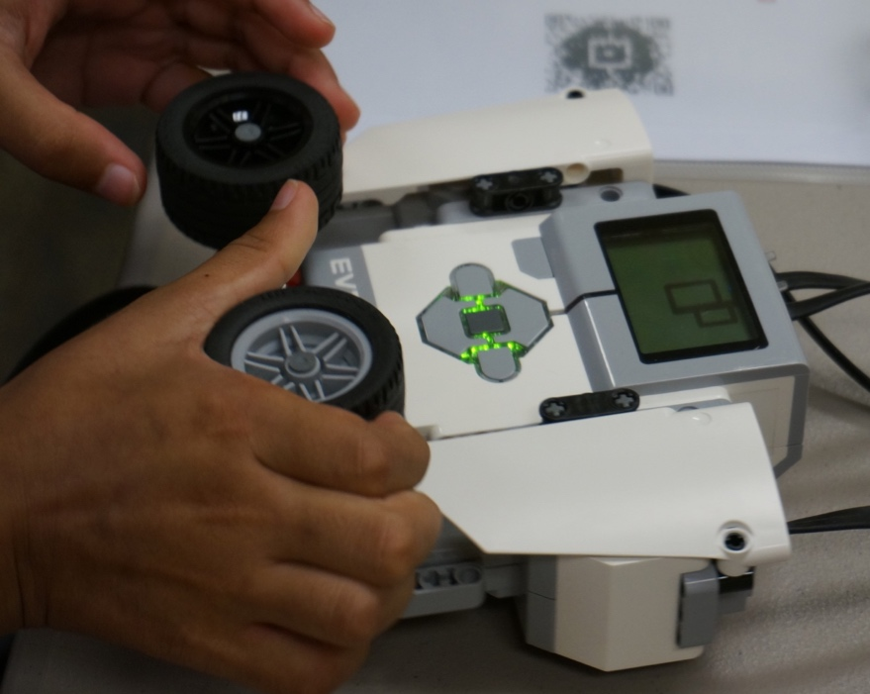
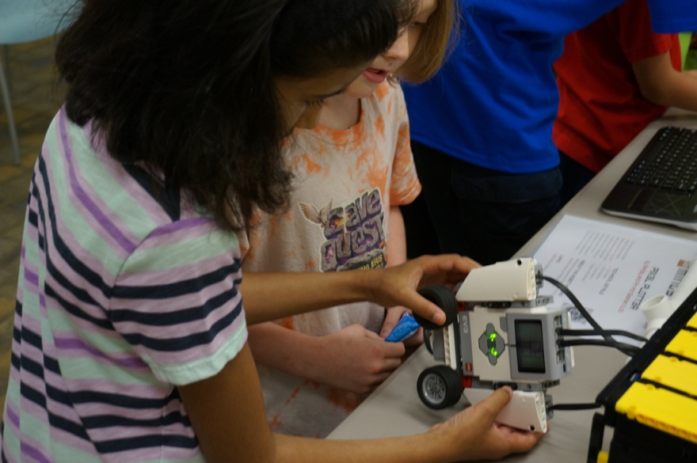
GYRO POSITION For a TILTING ROBOT
For a game like Etch-a-Sketch, where you tilt the entire robot to erase the screen, you need the gyro to be sideways (see image)
The gyro in this robot does not measure turns. It measures if you flipped the robot

Slide 8
Credits
This tutorial was created by Sanjay Seshan and Arvind Seshan
More lessons at www.ev3lessons.com
This work is licensed under a Creative Commons Attribution-NonCommercial-ShareAlike 4.0 International License.

