Slide 1
Squaring or Aligning on a Line

Slide 2
Lesson Objectives
Learn how to get your robot to square up (straighten out) when it comes to a line
Learn how squaring (also known as aligning on a line) can help the robot navigate
Learn how to improve initial code for aligning by repeating a technique
Practice creating a useful My Block
Prerequisites: My Blocks with Inputs & Outputs, Data Wires, Parallel Beams, Parallel Beams Synchronization

Slide 3
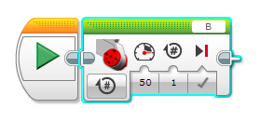
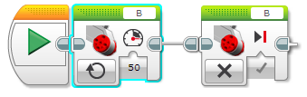
Review: Motor Movements
Move Steering lets you control both motors at the same time
What if you want to move or stop one motor at a time?
  Use the Large Motor Block
Large Motor Block
Large motor block in ON mode / OFF mode

Slide 4
Why Align on a Line?
Aligning on a line helps the robot navigate
  Robots get angled as they travel farther or turn (the error accumulates)
  Aligning on a line can straighten out a robot.
  Aligning can tell a robot where it is when it has to travel far
Example Goal: Your robot must deliver an object only inside a small END area. The distance between start and end is 8 feet
  Do you think your robot can travel 8 feet and continue to be straight?
End
8ft
Start

Slide 5
Three Easy Steps to Align
Challenge: Make the robot straighten out
(align/square up)
STEP 1: Start both motors
STEP 2: Stop one motor when the sensor on the corresponding side sees the line
STEP 3: Stop moving the second motor when the sensor on that side sees the line
Hints: Use a Large Motor Block, Use Parallel Beams, Use the Large Motor Block
(This slide is animated)

Slide 6
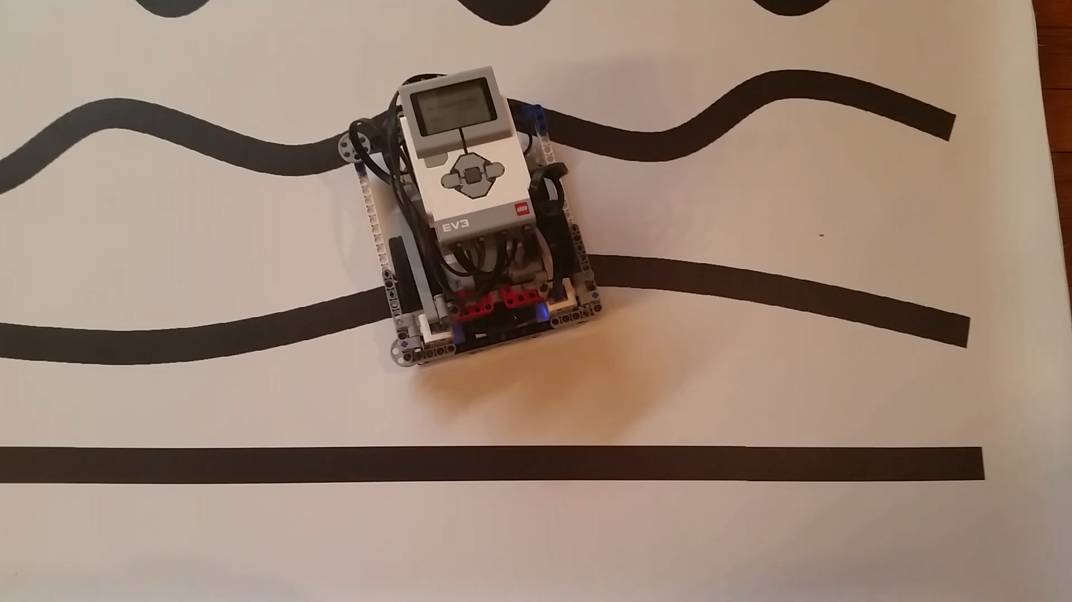
What Aligning Should Look Like

Slide 7
Notes About Our Solution:
Our solution uses 2 Color Sensors (connected in Ports 1 and 4).
Our solution assumes that the color sensor on port 1 is next to the wheel on motor port B and color sensor on port 4 is next to the wheel on motor port C.
You should adjust the ports as needed
Your color sensors should NOT be placed right next to each other (See red boxes below in robot image. These are the color sensors.)

Slide 8
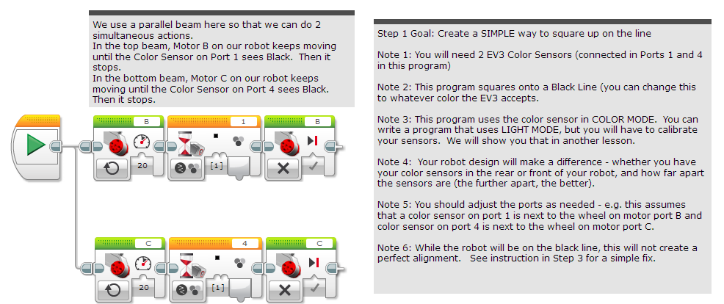
Basic Solution: Moving Until Line

Slide 9
Note: Synchronization & Parallel Beams
When you have two or more beams you do not know when each beam will finish.
If you wanted to move after the align finishes you might try to add a move block at the end of one of the beams.
  Note: This will not work because EV3 code will play your move block without waiting for the other beam to finish.
  Solution: You need to synchronize your beams. To learn more about synchronization and solutions go to the Advanced EV3Lessons.com Lesson on Sync Beams: PPTX, PDF , EV3 Code
The problem of synchronization can also be solved by making a My Block out of the align code.
  My Blocks always wait for both beams to finish before exiting

Slide 10
Improving Your Align Code
What do you notice about the solution we just presented?
  The robot isn’t quite straight (aligned) at the end of it.
  Both color sensors are on the line, but the robot stops at an angle.
Challenge Continued: Think about how you can improve this code so that the robot ends straighter
  Hint: Can you repeat the last process by looking for white?
  This assumes that the black line we were straightening out on has white on both sides.

Slide 11
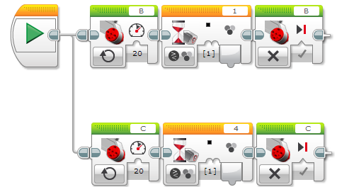
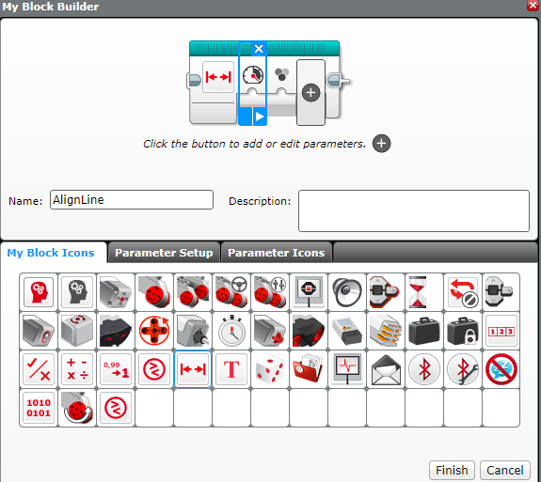
Improved Solution: Create a My Block
Highlight all the blocks then go to My Block Builder
Add 2 inputs: one for power and one for color
Refer to the My Blocks with Inputs & Outputs lesson if you need help setting up the My Block
A
B

Slide 12
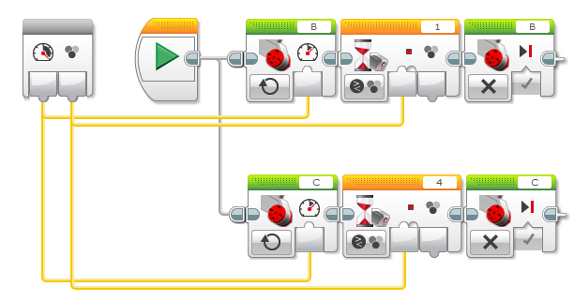
Improved Solution: Wire My Block
C. Wire the inputs in the grey block. The color input connects to both the color input in both Wait Blocks. The power value goes into the power input in both Move Steering Blocks.

Slide 13
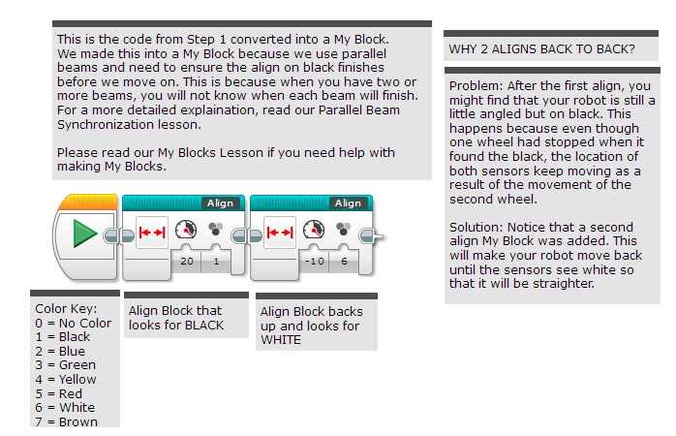
Improved Solution: My Block With Dual Stage Fix

Slide 14
Tips for Success
You will get better results
  ….if your color sensors are about 1cm from the ground
  ….if you shield your color sensors
  ….if you don’t come at the line at steep angles
  ….if you keep your color sensors spread apart

Slide 15
Discussion Guide
What does Aligning on a Line/Squaring mean?
Ans. It means when your robot comes at an angle, it can use a line to straighten out
Why does Squaring help when you travel long distances?
  Ans. Robots do not move accurately/straight. Squaring can help you know where you are and straighten out.
Why might it be useful to repeat the alignment process multiple times?
  Ans. Your robot will get straighter each time you repeat

Slide 16
Credits
This tutorial was created by Sanjay Seshan and Arvind Seshan from Droids Robotics.
  Author’s Email: team@droidsrobotics.org
More lessons at www.ev3lessons.com
This work is licensed under a Creative Commons Attribution-NonCommercial-ShareAlike 4.0 International License.

